Slide 1
CC Roundtable
Presentation
Michelle Wong

Slide 2
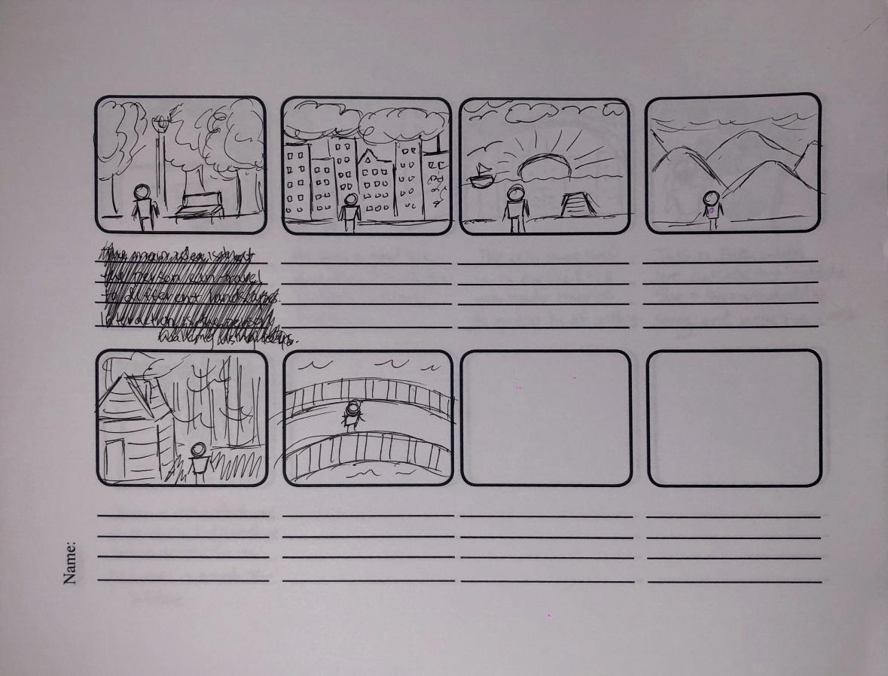

Slide 3

Tsuki Adventure by HyperBeard Inc.

Slide 4
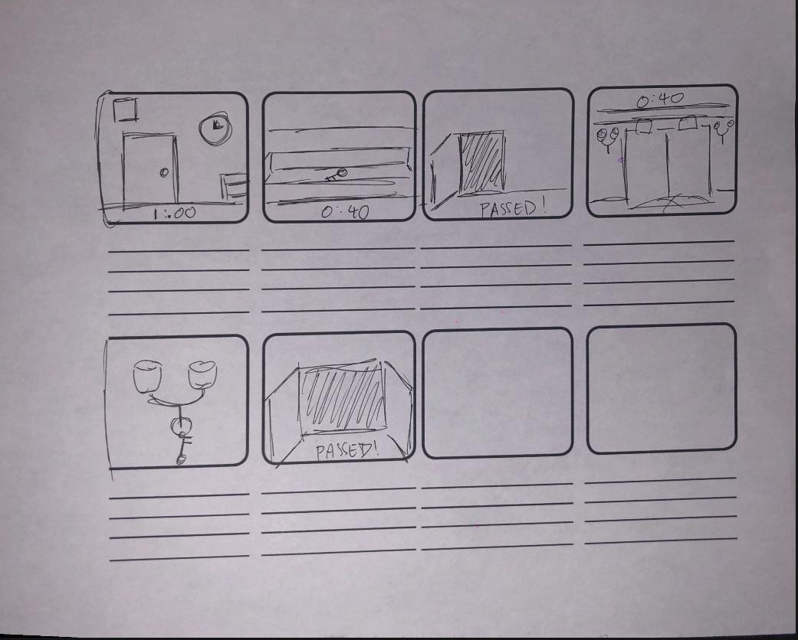

Slide 5
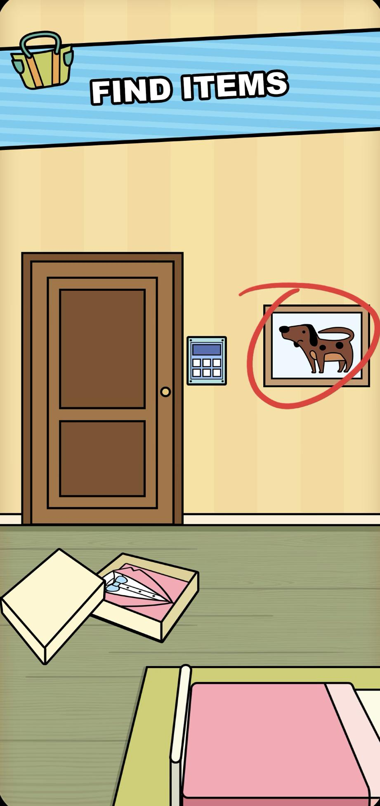


Slide 6
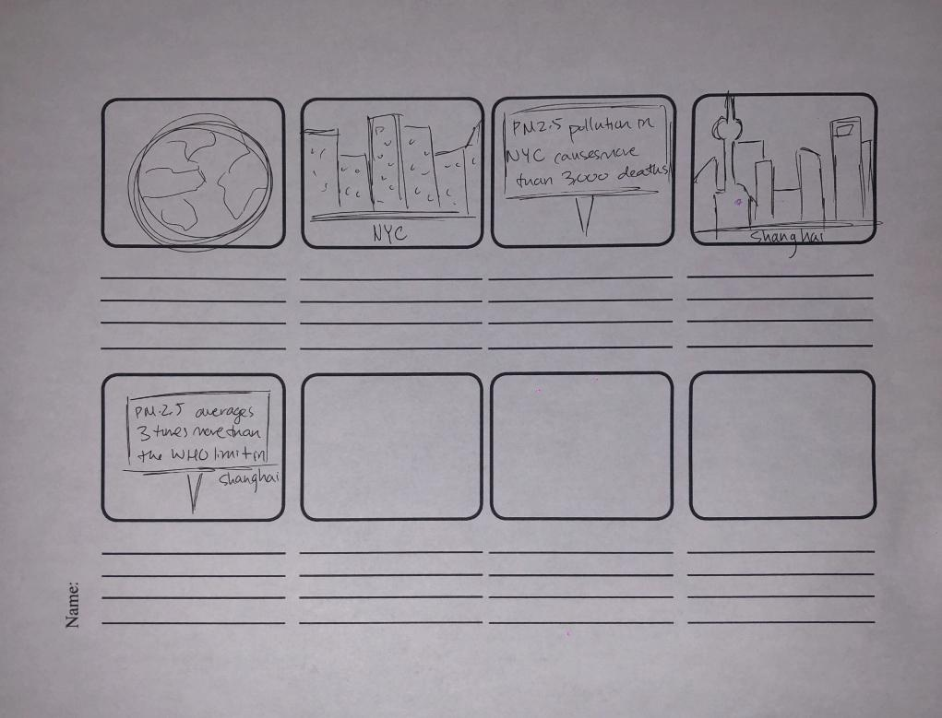

Slide 7
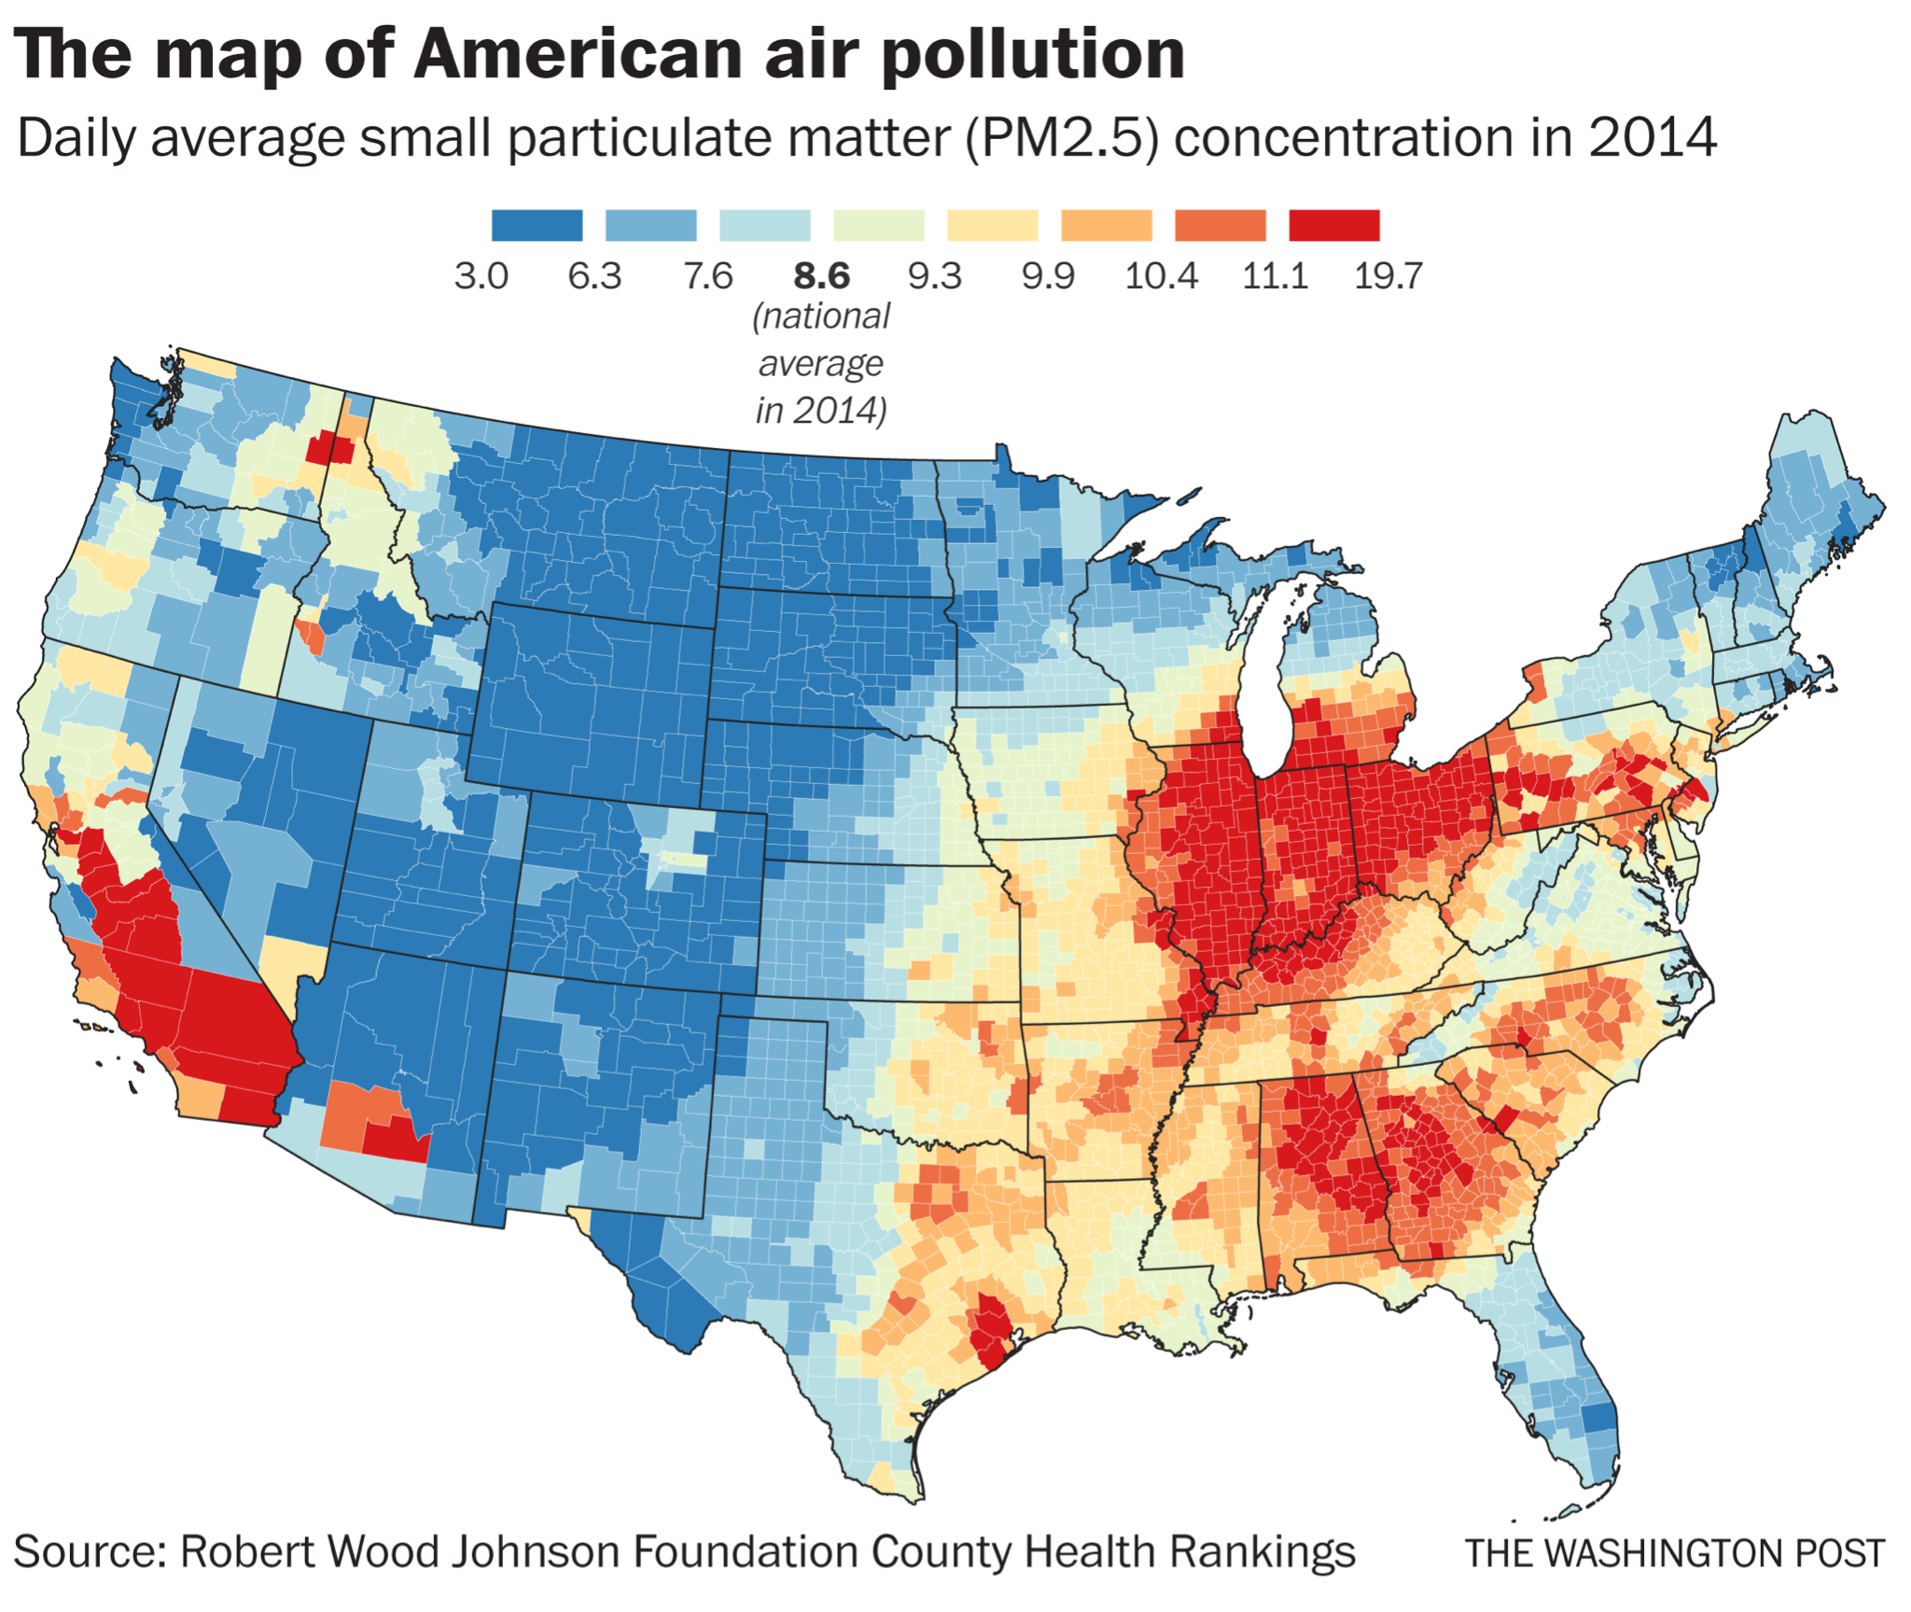
https://waqi.info
https://www.breezometer.com/air-quality-map/

